Slide 1
Coloured Line
4

Slide 2
Table of contents
Hypothesis
Measurement
Summary
Introduction
Problem definition
Observations
Hypothesis 1 – Refraction and diffraction
Measurements for hypothesis 1
Hypothesis 2 – Repeated reflection
Measurements for hypothesis 2
Other observed phenomena
Summary

Slide 3
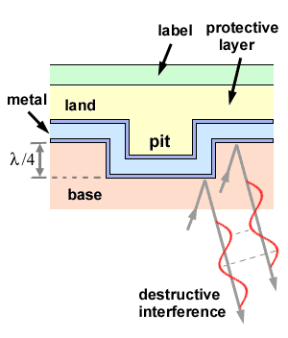
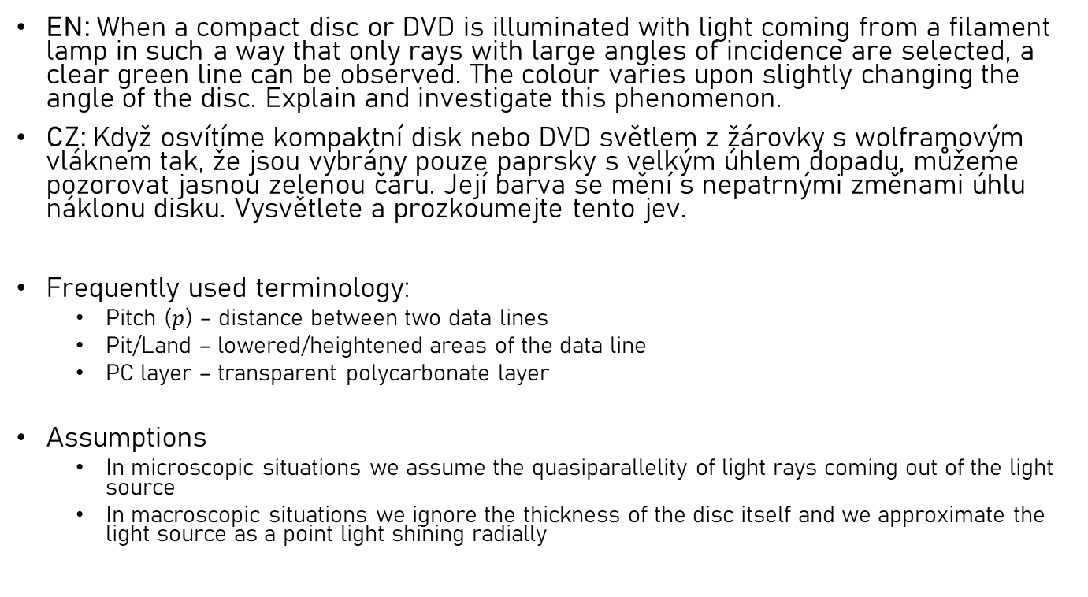
Problem definition
Introduction
Hypothesis
Measurement
Summary
EN: When a compact disc or DVD is illuminated with light coming from a filament lamp in such a way that only rays with large angles of incidence are selected, a clear green line can be observed. The colour varies upon slightly changing the angle of the disc. Explain and investigate this phenomenon.
CZ: Když osvítíme kompaktní disk nebo DVD světlem z žárovky s wolframovým vláknem tak, že jsou vybrány pouze paprsky s velkým úhlem dopadu, můžeme pozorovat jasnou zelenou čáru. Její barva se mění s nepatrnými změnami úhlu náklonu disku. Vysvětlete a prozkoumejte tento jev.
Frequently used terminology:
Pitch ($p$) – distance between two data lines
Pit/Land – lowered/heightened areas of the data line
PC layer – transparent polycarbonate layer
Assumptions
In microscopic situations we assume the quasiparallelity of light rays coming out of the light source
In macroscopic situations we ignore the thickness of the disc itself and we approximate the light source as a point light shining radially
Fig. 1: Construction of CDs [1]

Slide 4
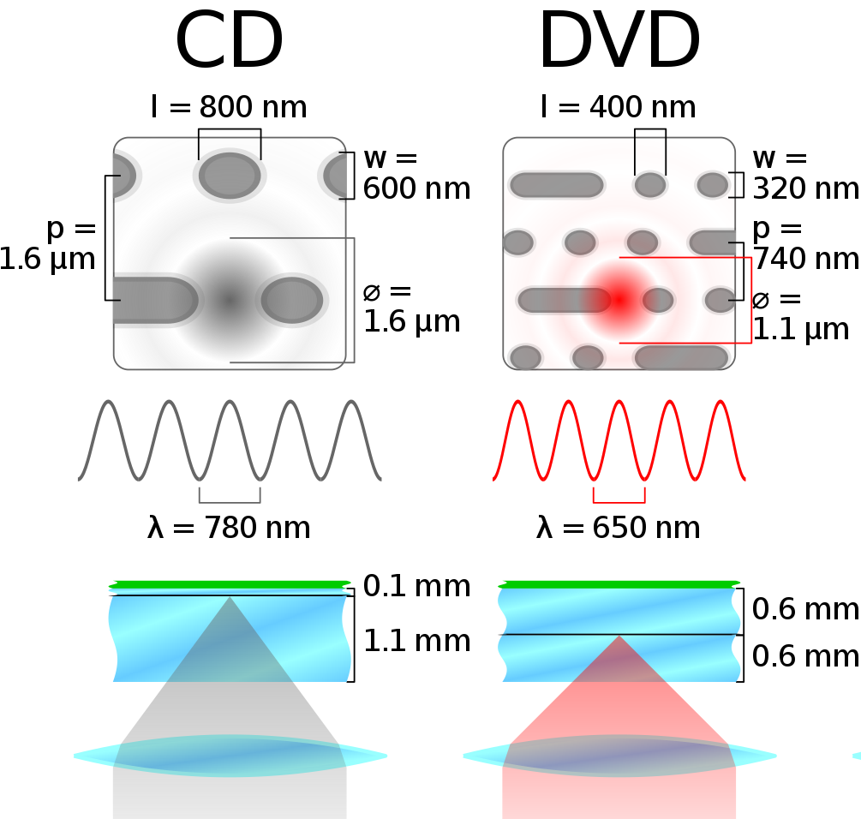
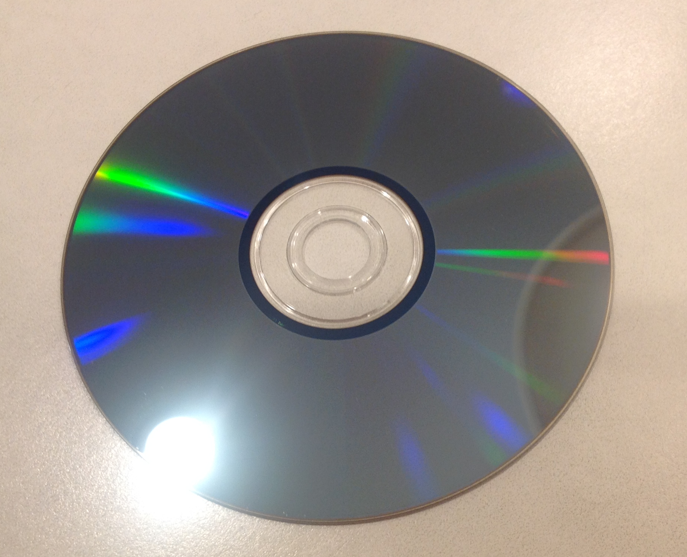
Observations
Hypothesis
Measurement
Summary
Introduction
Many optical phenomena, mainly colorful lines and curves can be seen on DVDs or CDs
Our goal is to explain some of these optical phenomena
Fig. 3: Comparison of construction of CDs and DVDs [3]
Fig. 2: Examples of optical phenomena [2]

Slide 5
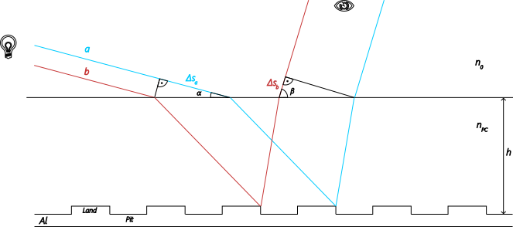
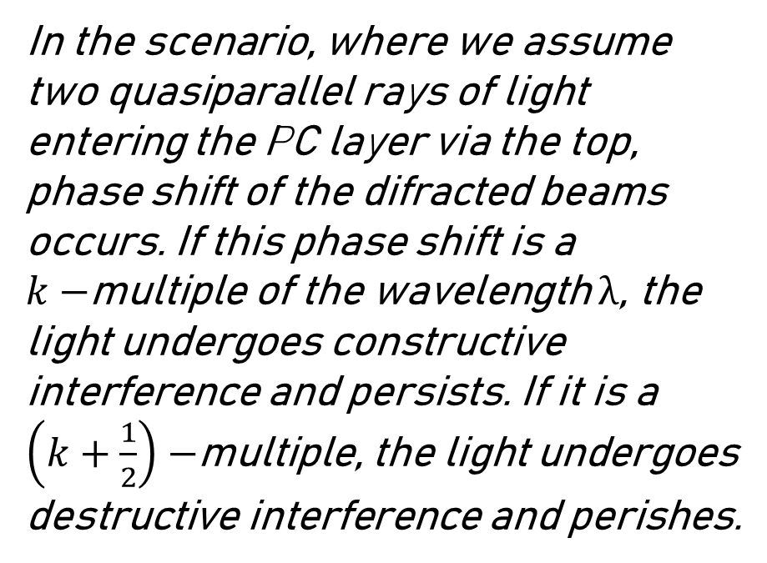
Hyp. 1 – Refraction and diffraction
Hypothesis
Measurement
Summary
Introduction
In the scenario, where we assume two quasiparallel rays of light entering the PC layer via the top, phase shift of the difracted beams occurs. If this phase shift is a $k−$multiple of the wavelength $λ$, the light undergoes constructive interference and persists. If it is a $\left(k+\frac{1}{2}\right)−$multiple, the light undergoes destructive interference and perishes.
Fig. 4: Diagram of two quasiparallel rays of light

Slide 6
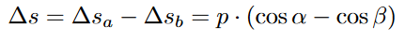
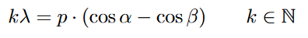
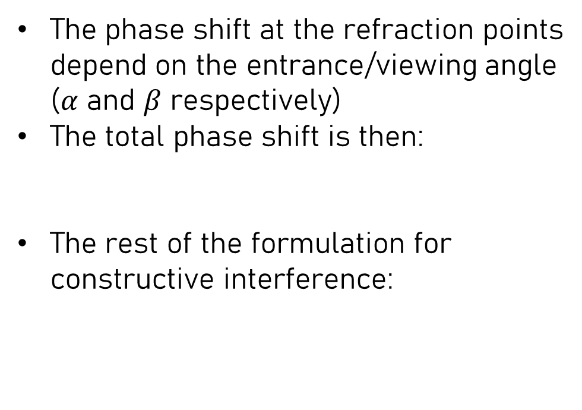
Hyp. 1 – Refraction and diffraction
Hypothesis
Measurement
Summary
Introduction
The phase shift at the refraction points depend on the entrance/viewing angle ($α$ and $β$ respectively)
The total phase shift is then:
The rest of the formulation for constructive interference:
Fig. 4: Diagram of two quasiparallel rays of light

Slide 7
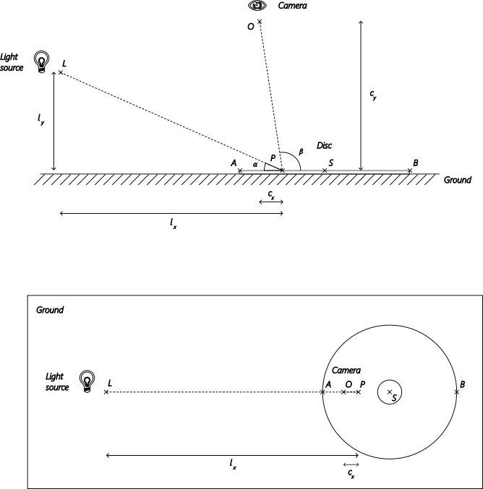
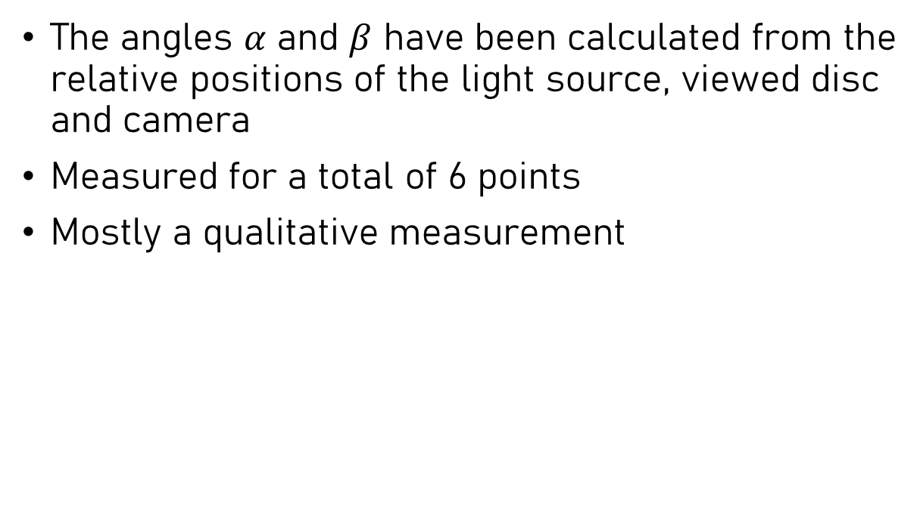
Measurements for hypothesis 1
Hypothesis
Measurement
Summary
Introduction
The angles $α$ and $β$ have been calculated from the relative positions of the light source, viewed disc and camera
Measured for a total of 6 points
Mostly a qualitative measurement
Fig. 5: Diagram of the experiment

Slide 8
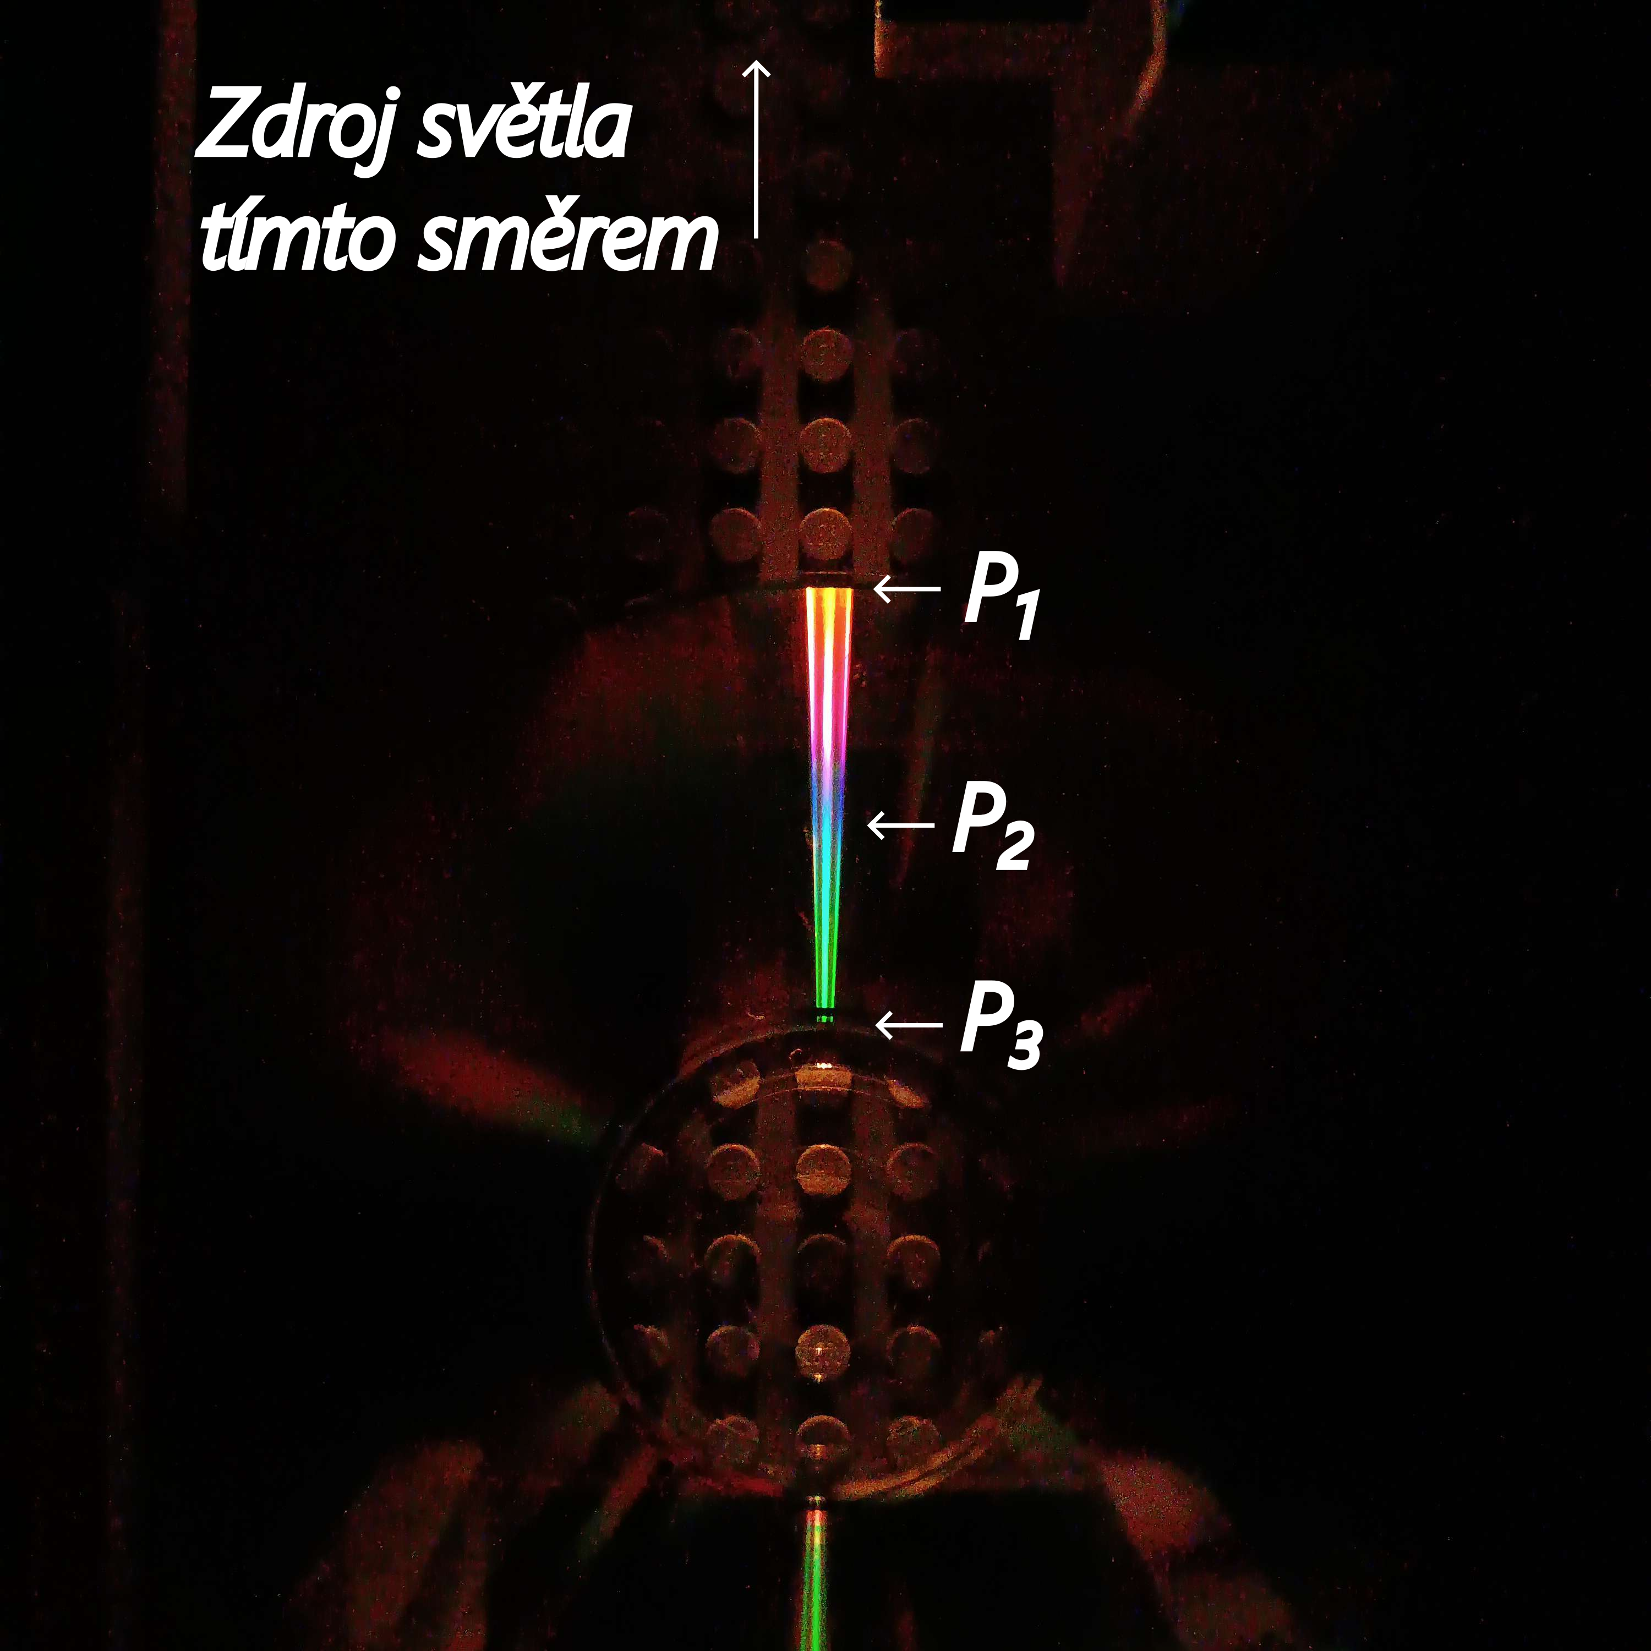
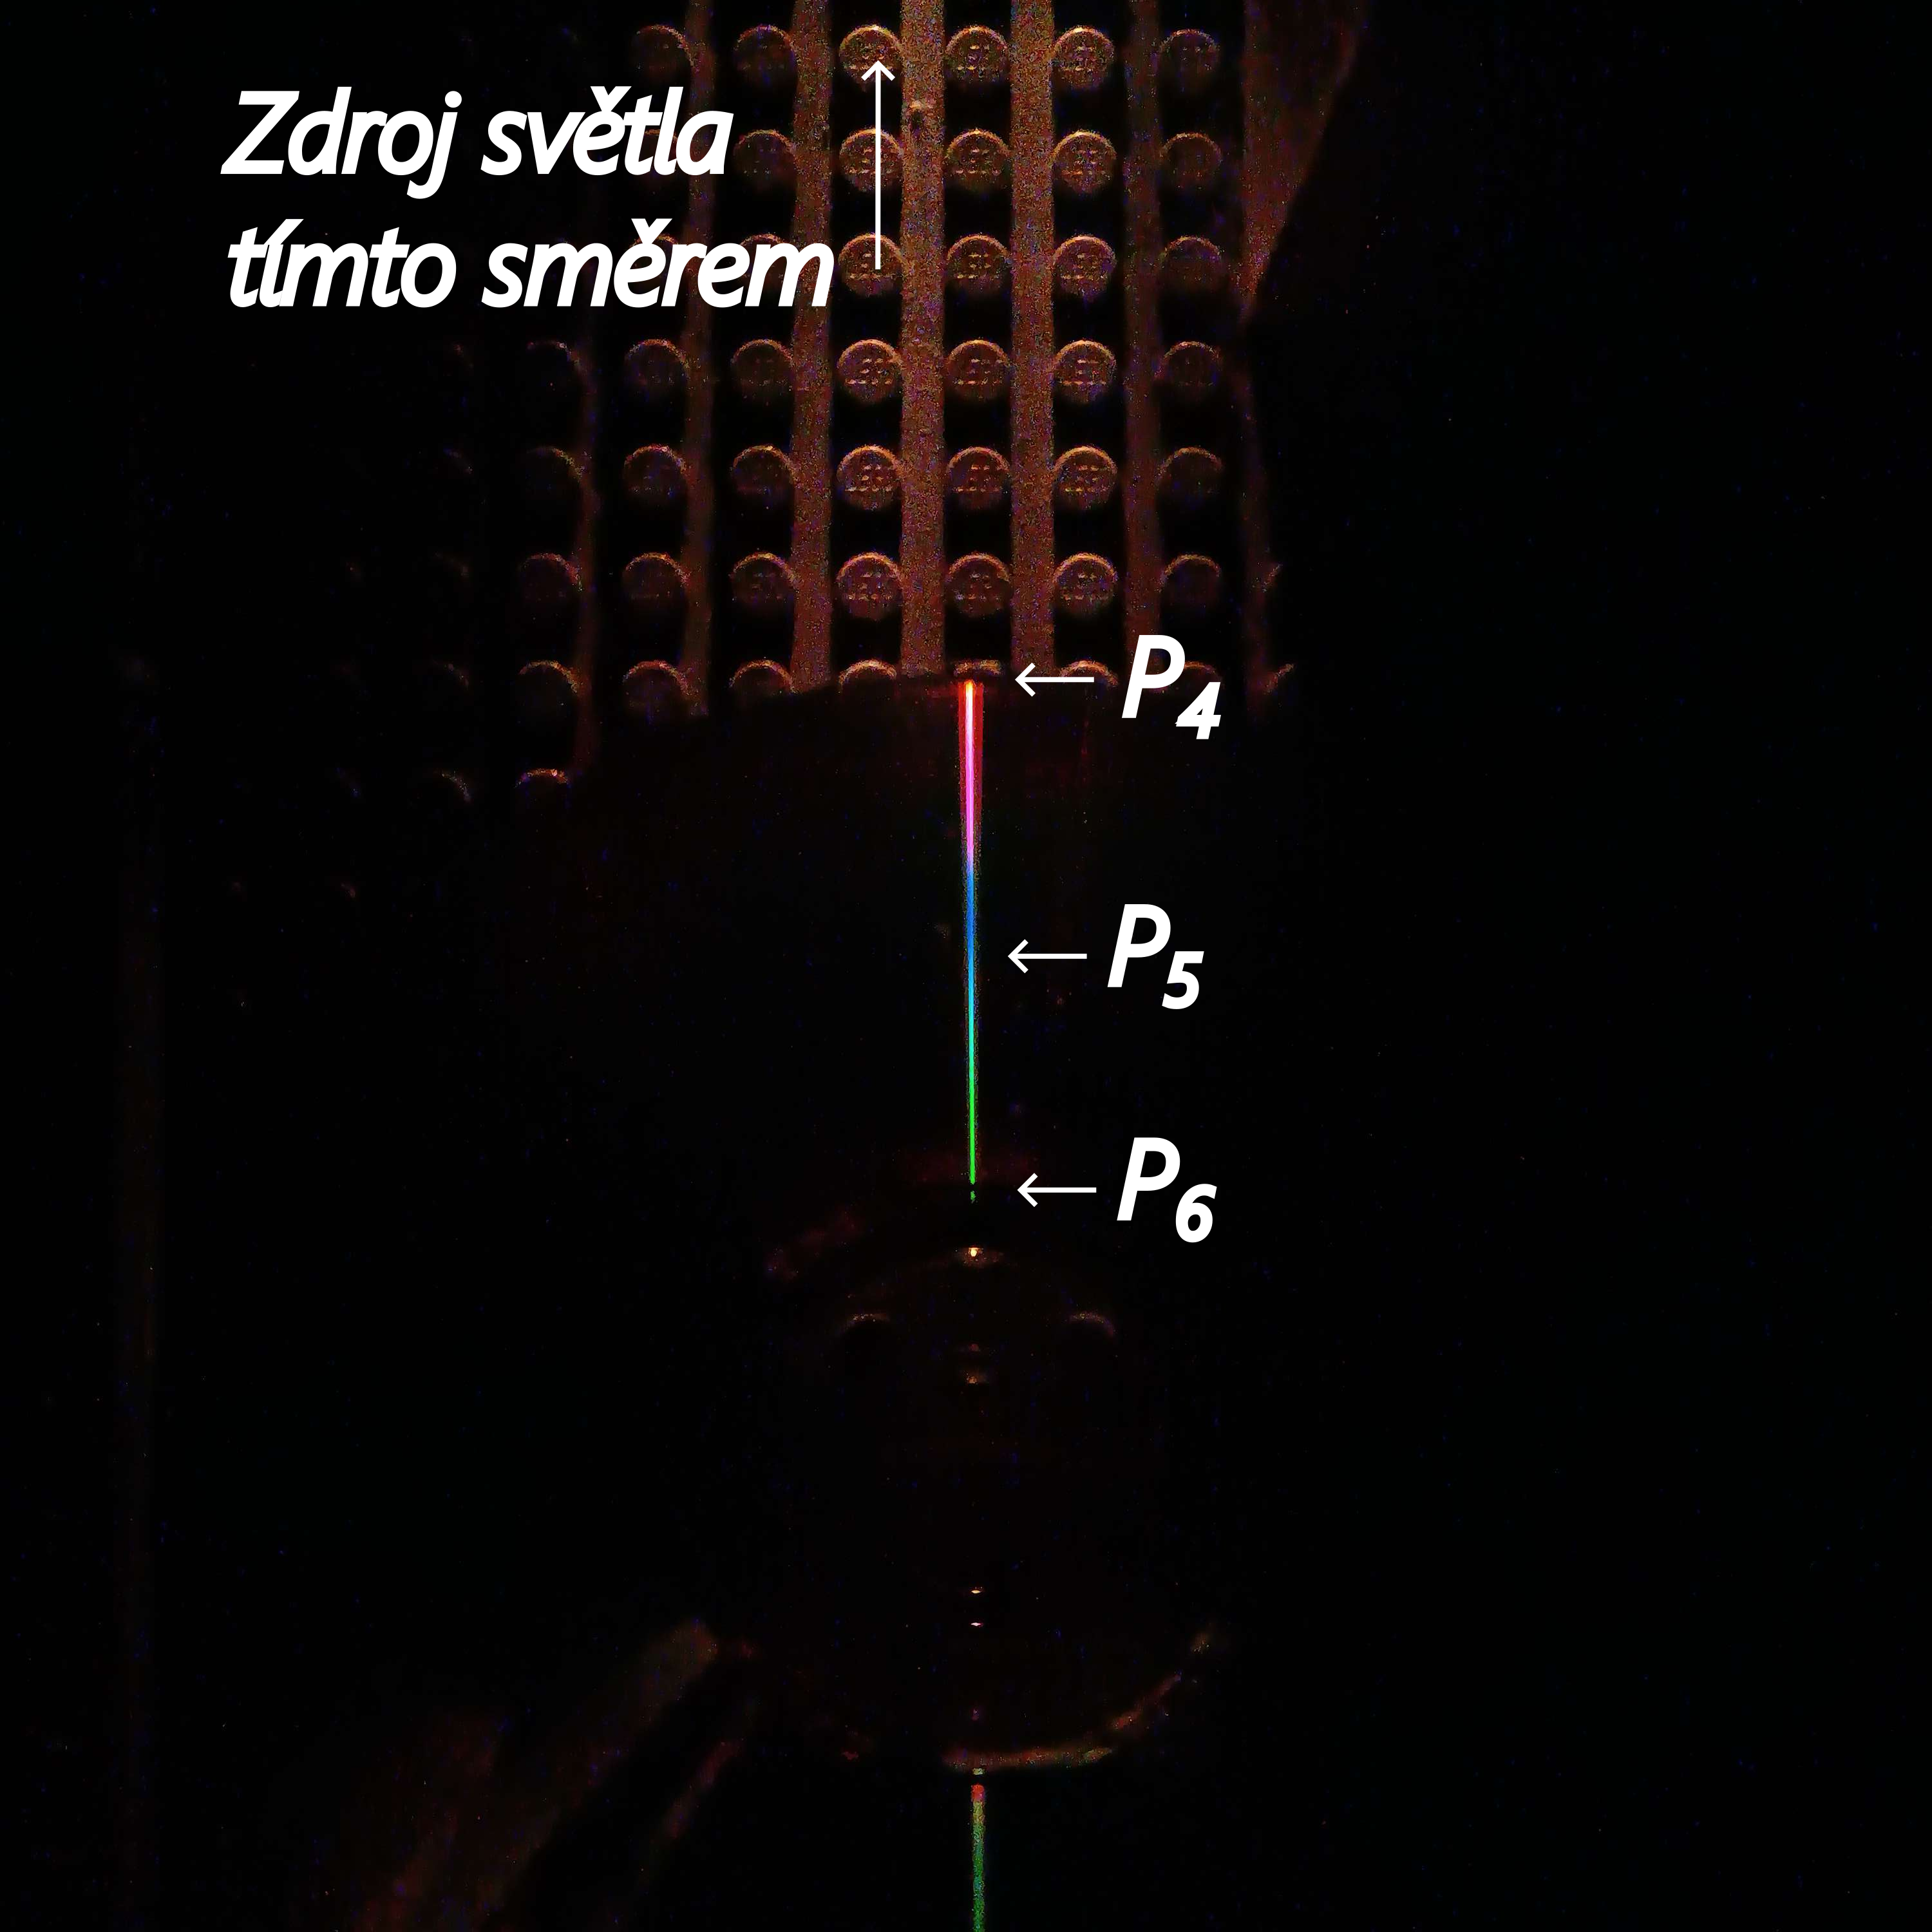

Measurements for hypothesis 1
Hypothesis
Measurement
Summary
Introduction
Fig. 6: Photos of the measured points

Slide 9
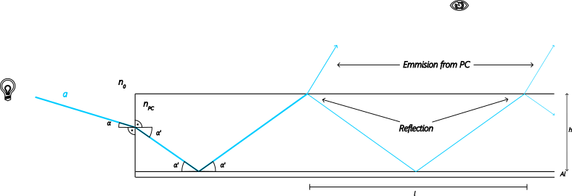
Hyp. 2 - Repeated reflection
Hypothesis
Measurement
Summary
Introduction
In the scenario, where a ray enters the PC layer of the disc via the side, the ray can experience multiple reflections within that layer. During each reflection some part of it‘s energy may be emmited. These reflections will be spaced evenly.
Fig. 8: Diagram of a ray being repeatedly reflected within the PC layer

Slide 10
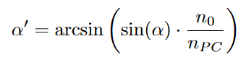
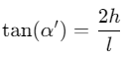
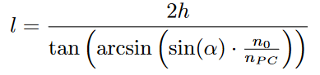
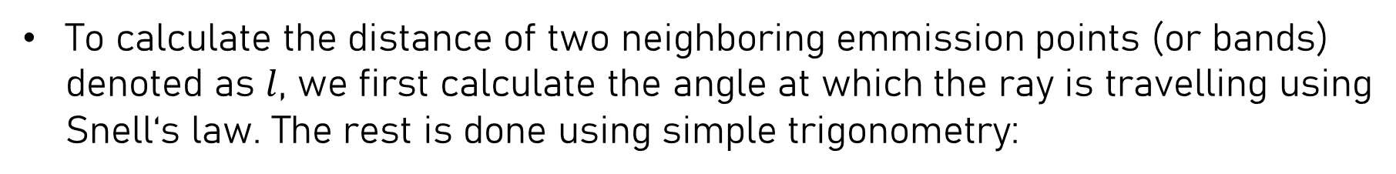
Hyp. 2 - Repeated reflection
Hypothesis
Measurement
Summary
Introduction
To calculate the distance of two neighboring emmission points (or bands) denoted as $l$, we first calculate the angle at which the ray is travelling using Snell‘s law. The rest is done using simple trigonometry:
Fig. 8: Diagram of a ray being repeatedly reflected within the PC layer

Slide 11
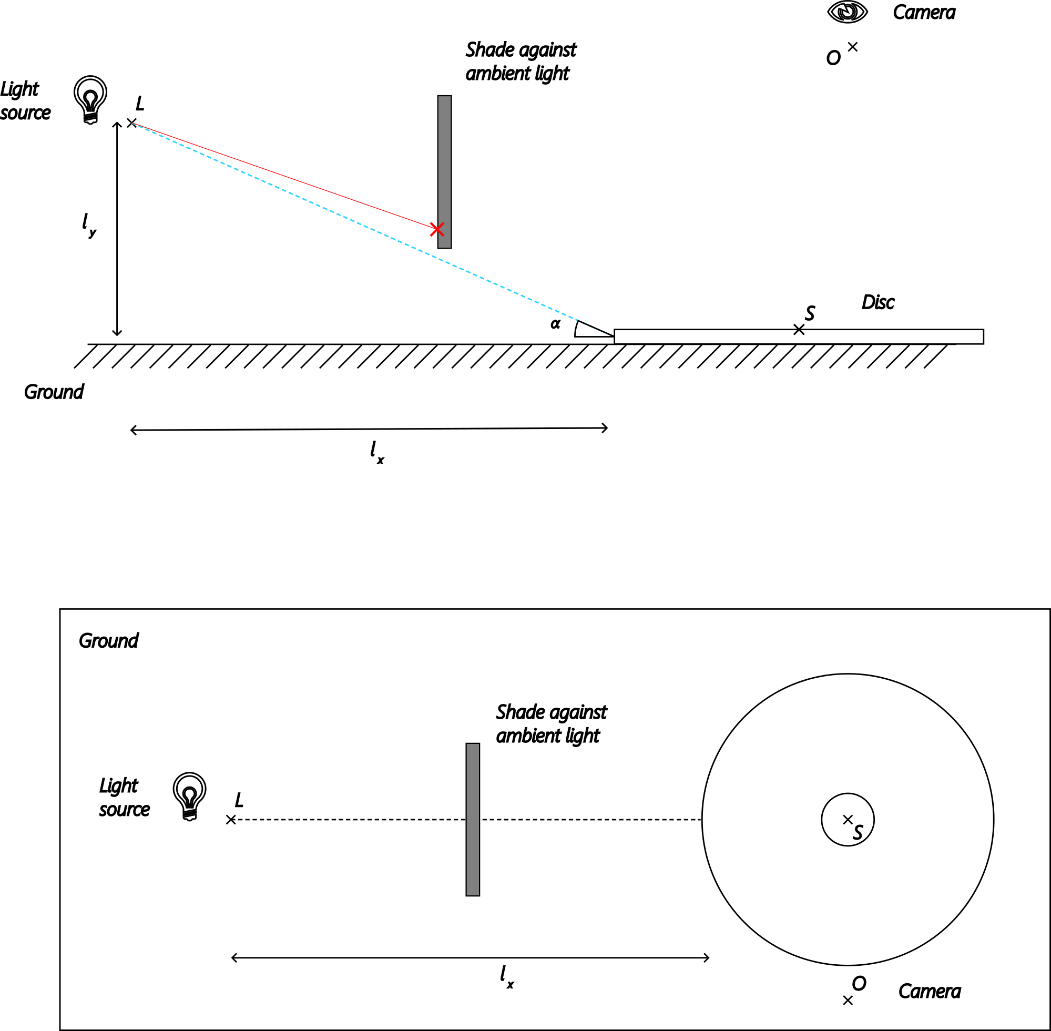
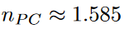
Measurements for hypothesis 2
Hypothesis
Measurement
Summary
Introduction
The measurement was done simply by shining a light at the side of the CD from a known position
From that the angle was calculated
Ambient light was blocked using a shade, that greatly reduced the amount of light hitting the disc from the top
Refractive index of the PC layer used [4]:
Fig. 9: Diagram of the experiment

Slide 12
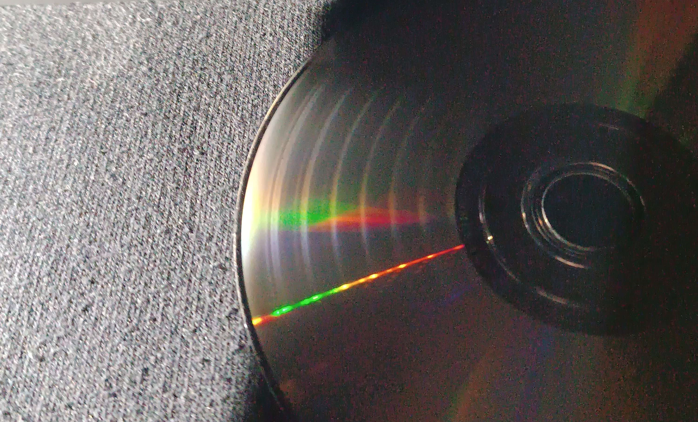
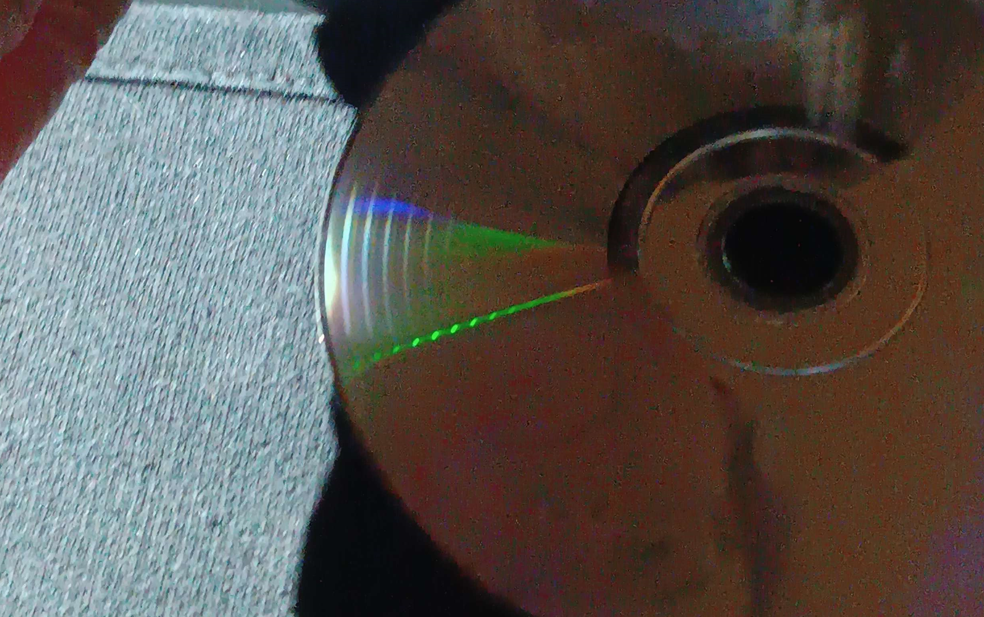
Measurements for hypothesis 2
Hypothesis
Measurement
Summary
Introduction
Measurements done for two different configurations
Both results fit the theory very well
Fig. 10,11: Photos of the
measured phenomena

Slide 13
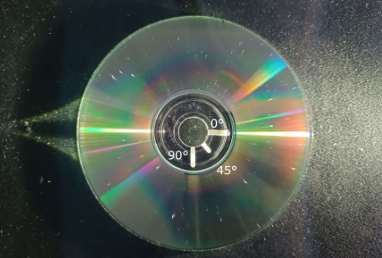
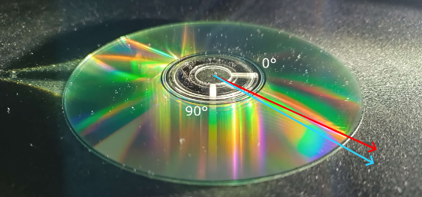
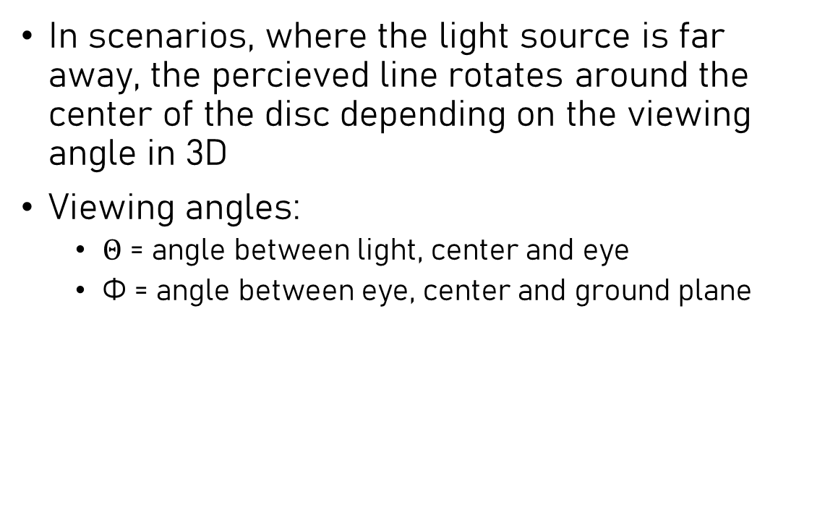
Other observed phenomena
Introduction
Hypothesis
Measurement
Summary
In scenarios, where the light source is far away, the percieved line rotates around the center of the disc depending on the viewing angle in 3D
Viewing angles:
$Θ$ = angle between light, center and eye
Φ = angle between eye, center and ground plane
Notes:
Light, střed, P (okrajový bod čáry) = gamma Light, střed, oko = theta
Oko, střed, podložka = phi

Slide 14
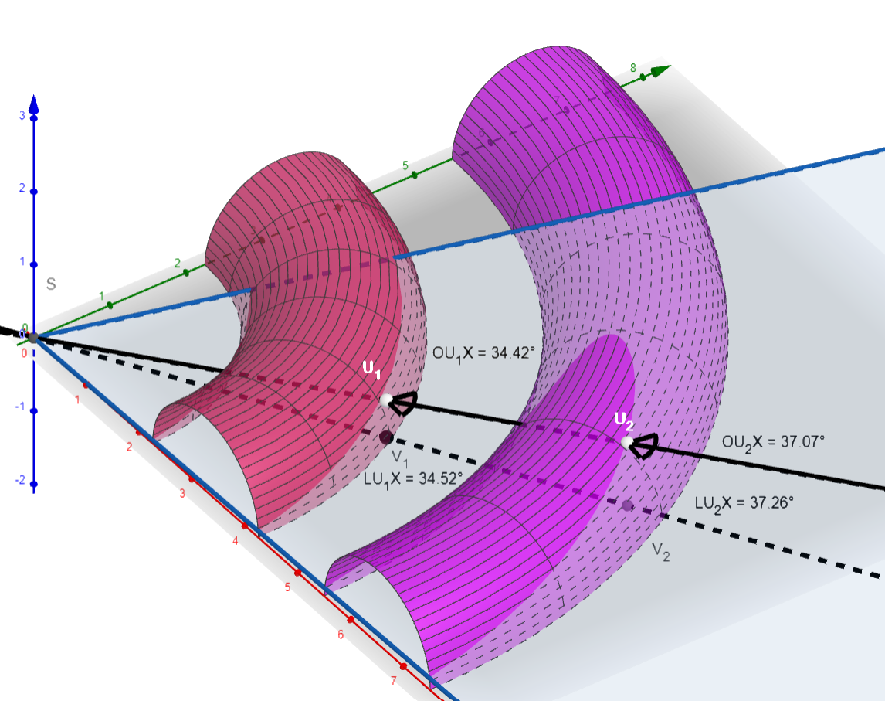
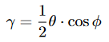
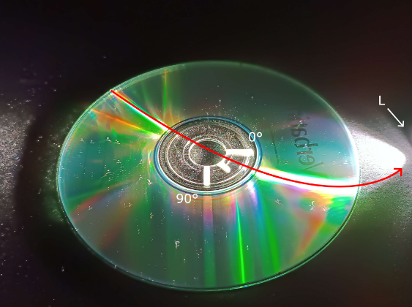
Other observed phenomena
Introduction
Hypothesis
Measurement
Summary
Our approximation devised from the 3D geometry a disc:
If the light source is close, the line starts curving towards the source
Notes:
Light, střed, P (okrajový bod čáry) = gamma Light, střed, oko = theta
Oko, střed, podložka = phi

Slide 15
Future improvements
Introduction
Hypothesis
Measurement
Summary
Quantitative measurements for hypothesis 1
More total measurements for hypothesis 1

Slide 16
Summary
Introduction
Hypothesis
Measurement
Summary
We were able to create a hypothesis for the behaviour of the lines. We came up with a formula for the color of such line at any given point and confirmed it qualitatively.
We created a hypothesis for the cause of the banding artefacts. We came up with a formula for the distance of these bands and confirmed it quantitatively.
We also came up with an approximate relation of the line angle from the viewing angles

Slide 17
Additional sources
Introduction
Hypothesis
Measurement
Summary
[1] Chris Mueller, 26.6.2015, wOhON.gif, viewed 20.12.2022,
https://engineering.stackexchange.com/questions/3324/why-is-it-more-reliable-to-use-the-land-pit-transition-in-a-cd-rom
[2] Jon Abe, 10.9.2014, photo1.png, viewed 20.12.2022, https://joabe808.wordpress.com/2014/09/10/optics-cd-rainbow-reflection/
[3] Cmglee, 6.6.2021, File:Comparison_CD_DVD_HDDVD_BD.svg, viewed 20.12.2022, https://en.wikipedia.org/wiki/Comparison_of_high-definition_optical_disc_formats
[4] Trisha, 25.4.2012, DVD-Rainbow.jpg, zobrazeno 20.12.2022, https://inspirationlaboratories.com/how-to-make-a-rainbow/dvd-rainbow/

